Slide 1
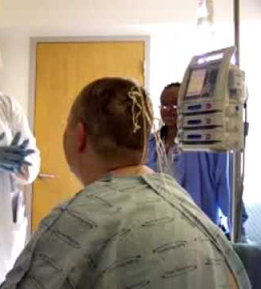
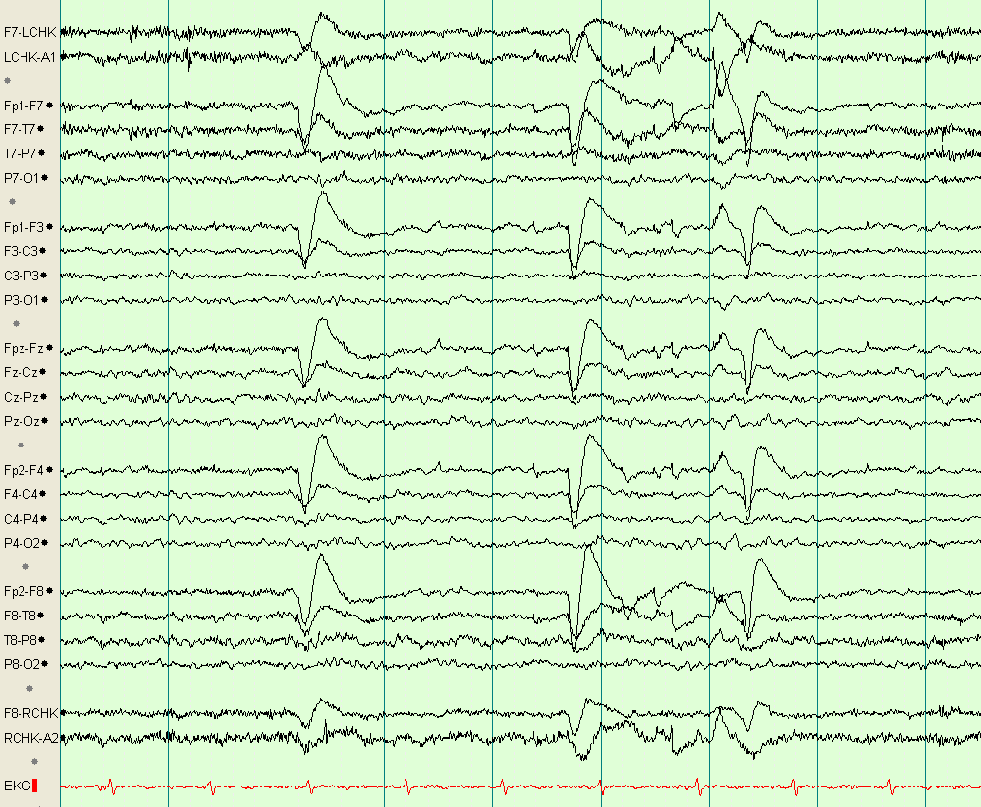
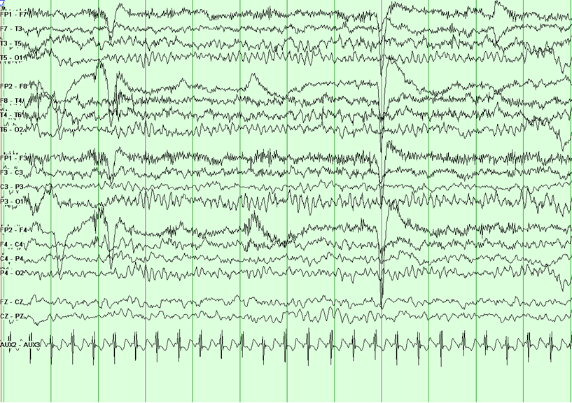
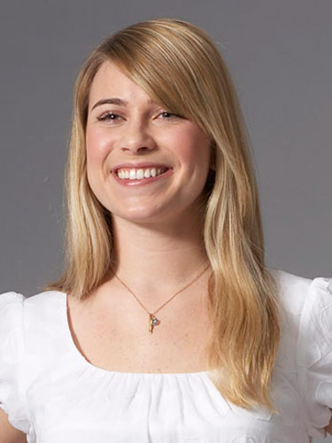
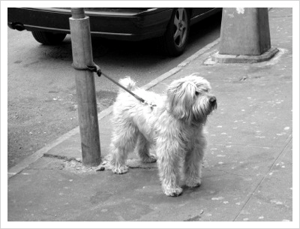
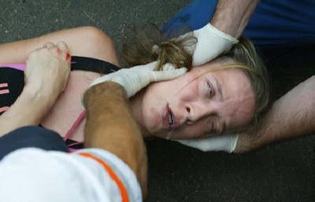

Slide 2
WIRELESS NEURAL RECORDER
UNTETHERING 70 MILLION EPILEPSY PATIENTS AROUND THE WORLD
Stephen Xia Tingkai Liu Yuan Gao Xin Huang

Slide 3
1% of Population | 10 - 25 Million Operations/Year
5 - 6 Days per Operation

Slide 4
CUSTOMERS – EEG service providers
Hospitals | Clinics | Research Institutes
4000 | 5000 | 150

Slide 5
Total Market Value
Customers * Machines * Unit Price
$ 290 Million

Slide 6
Customer Needs
Safety (FDA, HIPAA, WHO MDR)
Accuracy & Reliability, Real-time
Convenience & Mobility, Low Power:
Application development platform

Slide 7
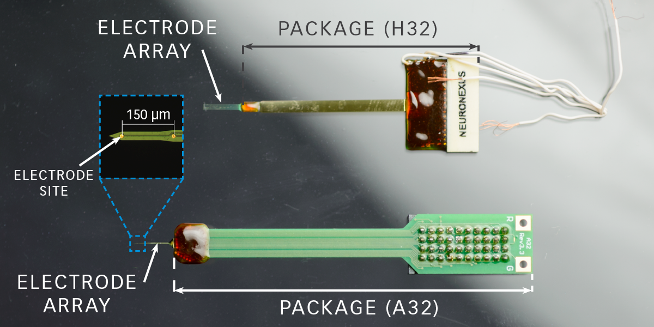
NeuroNexus
Wired Connection
Large Package

Slide 8
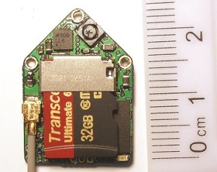
Deuteron
Animal Usage
Big in size
Non real-time

Slide 9
Design Specifications
Customer Needs | Design Specifications
Safe | Skin Temperature Change: < 2C Feedback Current: 0 mA
Real-Time | Transmission Rate: 128 kB/s Sampling Rate: 1 kHz
Accurate and Comprehensive | Sampling Precision: 16-channel, 8-bit Sampling Rate: 1 kHz
Low Power and Long Lasting | Battery Life: at least 24 hours
Portable and Convenient | Module Size: 4x4 mm

Slide 10

System Diagram

Slide 11

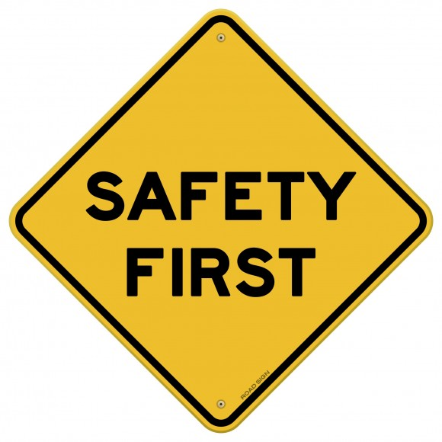
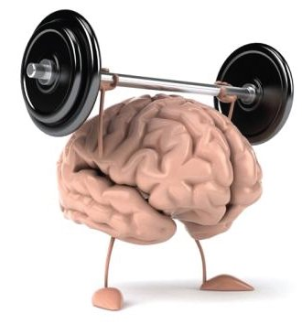
Challenges

Slide 12
Wireless Options
5 Potential Options for Wireless Data Transfer
Bluetooth Low Energy
Wifi 2.4 / 5 GHz
Other RF Bands
Zigbee
NFC

Slide 13
Wireless Options
5 Potential Options for Wireless Data Transfer
Bluetooth Low Energy
Wifi 2.4 / 5 GHz
Other RF Bands
Zigbee
NFC

Slide 14
Bluetooth Low Energy
Most likely use BLE as our transmission source with a TI CC2640 BLE 4.2
Industry-leading privacy. Keeps Bluetooth Smart devices from being tracked.
Highly secure. Features industry-standard encryption ensuring confidential data stays that way.
More power efficient. Introduces refinements that make Bluetooth Smart even more power-stingy.

Slide 15
Power Options
Powering the electrode is a huge challenge due to size and longevity constraints
2 Options
High density replaceable medical device batteries
Inductive charging via brain’s electrical impulses

Slide 16
Power Options
Powering the electrode is a huge challenge due to size and longevity constraints
2 Options
High density replaceable medical device batteries
Inductive charging via brain’s electrical impulses

Slide 17
Prototype Plan
3 Stages of prototyping with testing and iterating
Stage 1
Single electrode circuit prototype testing BLE technology with generated signals from oscilloscope
Stage 2
Multiple electrodes prototype to test multi-system communications
Stage 3
Full 16 electrode system with mobile recording device and animal testing

Slide 18
Wireless Neural Recorder
Applications not only limited to epilepsy
◦ Sleep diagnosis
◦ Diagnosis diseases of the brain
◦ Coma analysis
◦ Brain stimulation
Improve Epilepsy patients’ quality of life
◦ Untether them from the limitation of existing technology
◦ Improve monitoring with more data for better procedural

Slide 19
